Slide 1
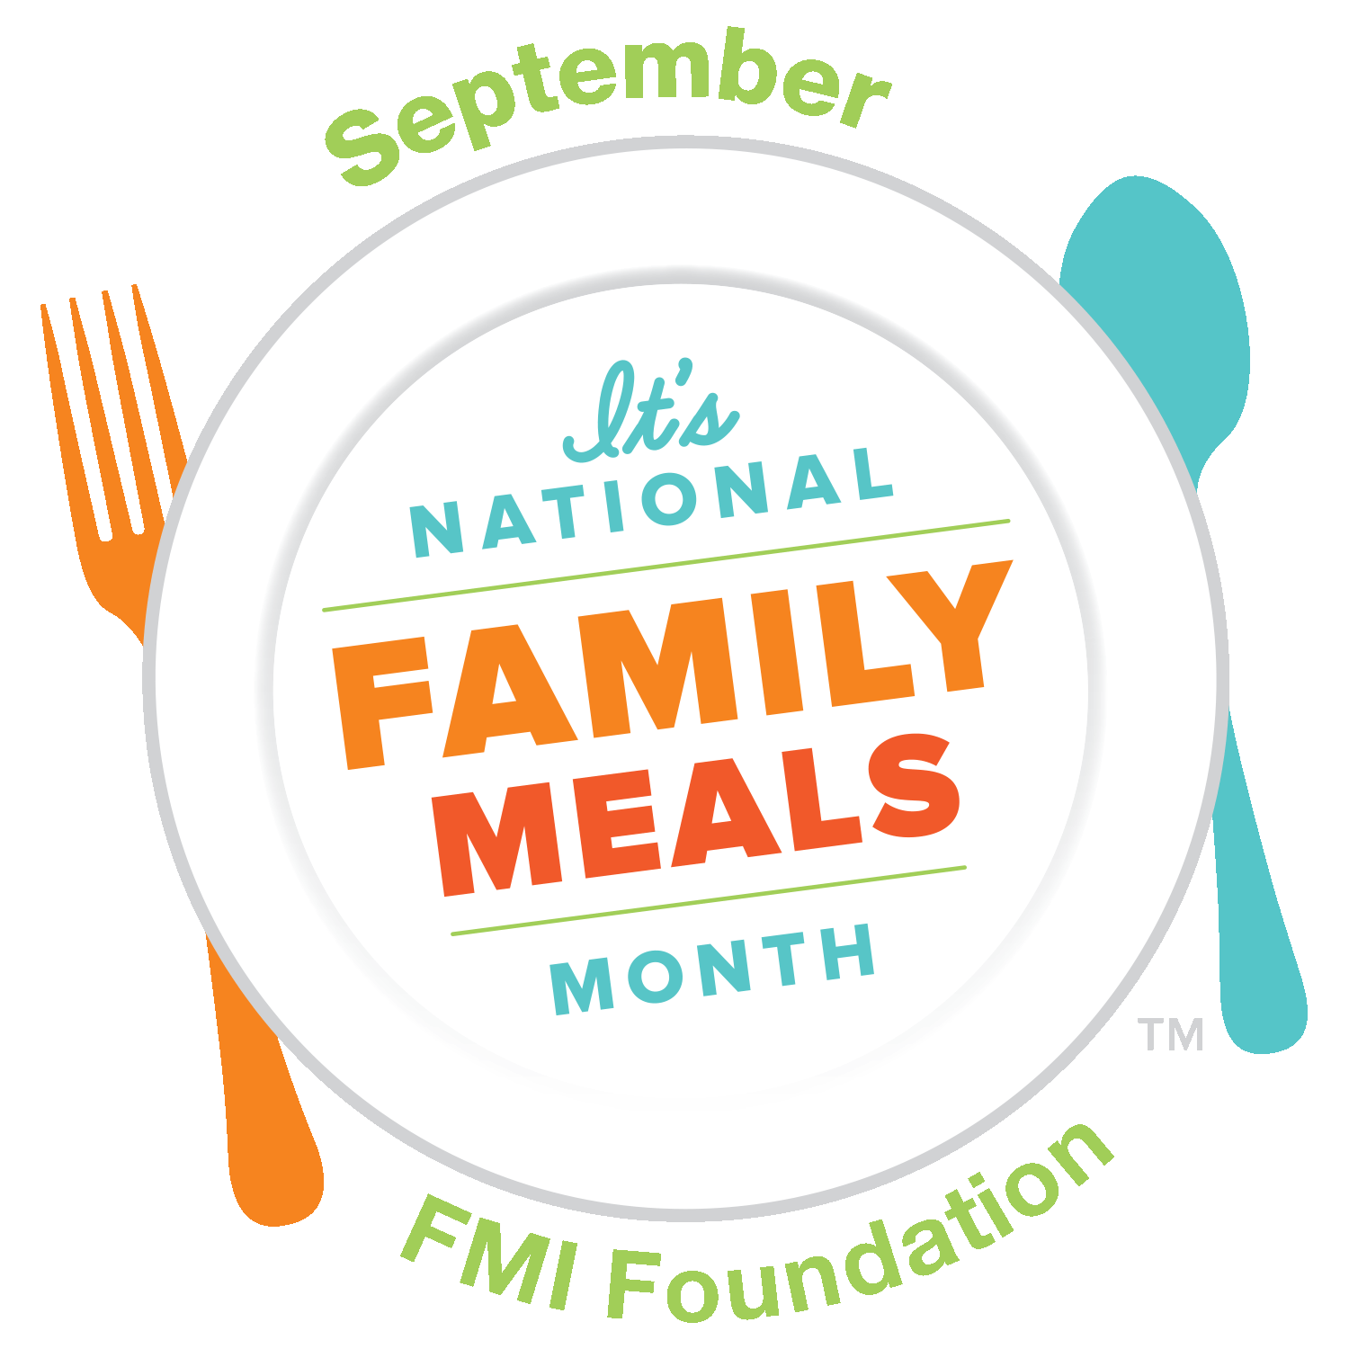
A Simple Way to Raise, Healthier, More Successful, Safer Kids!
Notes:
Presenters, please note the following:
-For citations of the research substantiating the claims in this lesson, please download the Family Meals Month Research file, feel free to use the file to add additional factoids to stress the importance of family meals month with your clients.
-This class can be done with a group in 20 minutes, possibly shorter depending on how interactive you make it.
- For one on one lessons, you can ask your client to choose which one of the barriers to family meals they struggle with the most and focus on that to save time and personalize the material
-This presentation has animation to help you pace the information/discussion
-If you are using any handouts like recipes, cooking hacks, or meal planning sheets (all also available on our website) wait until the end of the lesson to pass out
-If you can do a food demo this is a good way to end the lesson or possibly start with the demo so people can eat while they listen

Slide 2







What if there was one thing you could do to make your children:
Healthier
More Successful
Safer
There is!
Notes:
Script:
What if there was ONE thing you could do that would help your child be:
Healthier by eating more fruits, vegetable, and whole grains
AND
More Successful by earning higher tests scores and having better self esteem
AND
Safer by being less likely to smoke cigarettes or use alcohol or marijuana?
There is!

Slide 3
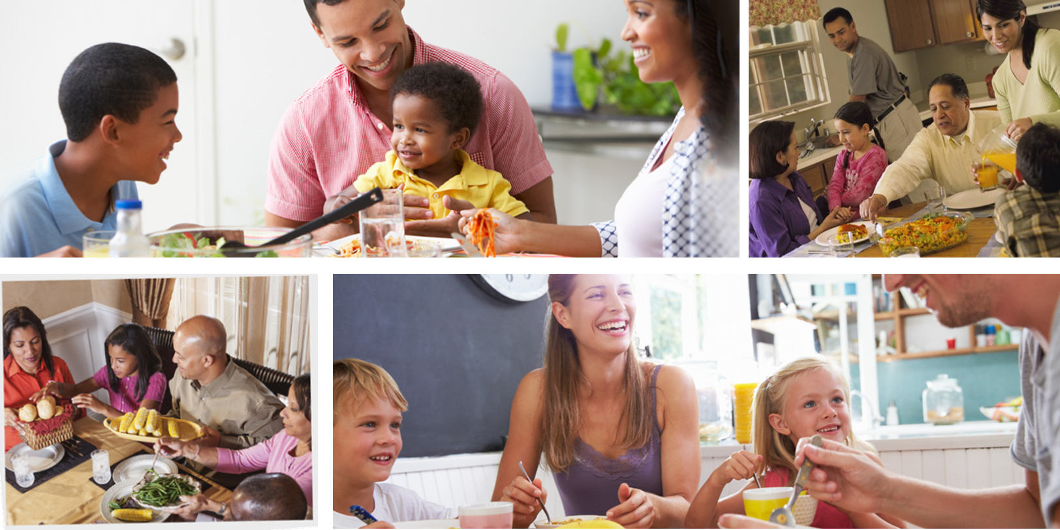
Eating More Meals as a Family!
17%
Meals Skipped = Missing Nutrition
25%
Meals Eaten Alone =
Fewer family connections
20%
Meals Eaten Away From Home =
Over Eating + Fewer Healthy Foods
Notes:
Script:
You can do all these things for your child by eating more meals as a family
Think about it:
Restaurant and take out menus don’t always have whole grain or good fruit and vegetable options. Meals made at home offer more options for wholesome choices
Now it’s not enough to eat meals prepared at home, sitting together as a family offers time to connect. Children learn better social habits, you have a chance to check in on how they are doing, and all this adds up to more success in the classroom and social situations where peer pressure could steer them in the wrong direction.
*advance the animation as you talk about the following stats*
Script:
Unfortunately
-17% of meals are skipped altogether. As a result a lot of families miss out on important nutrition.
-20% of meals are eaten out at restaurants or other away from home locations. Which can lead to overeating doe to larger restaurant portions or fewer healthy options.
-Lastly, 25% of meals are eaten alone, meaning that families are missing out on the chance to connect with their loved ones, check in on their kids, and support each other.

Slide 4





Why Don’t More Families Eat Together?
Not Enough Time
Can’t Cook
Picky Eaters
To Expensive
Notes:
Script:
So if family meals are so important, why don't more families enjoy them together?
For the remainder of our time together, we are going to look into a couple ways to overcome 4 common reasons why families don’t enjoy more family meals:
Not having enough time to cook
Not feeling confident in the kitchen
Having picky eaters in the family
Expensive ingredients
Let’s look at these concerns in more detail and see what you can do to overcome these barriers.

Slide 5
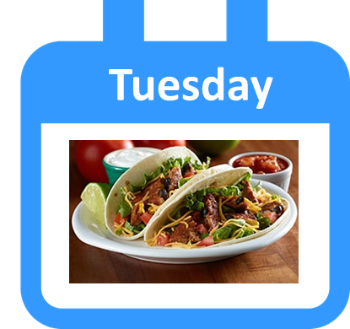
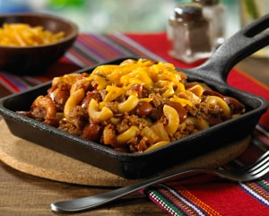
Time Savers
Breakfast is a meal!
Prepare for the day ahead together.
Create 1-2 theme nights for easier meal planning.
One pot meals and make ahead cooking get save time
Notes:
Script:
If schedules don’t allow for more family dinners, family breakfasts or weekend lunches are options. Assuming weekday lunches are not possible because of work, school, or other obligations if you count breakfast and weekend lunchtime, you have 16 opportunities a week to have a family meal
Try theme nights so you don’t have to think or plan for 1-2 nights a week and the family knows that to expect . Examples include taco Tuesday, meatball Monday… don’t worry, the meal does not have to start with the same letter as the day of the week!
One pot or one sheet meals and make ahead cooking are all ways to save time cooking and cleaning up.

Slide 6
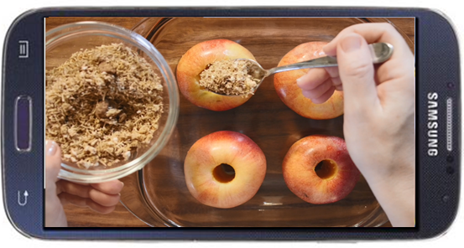
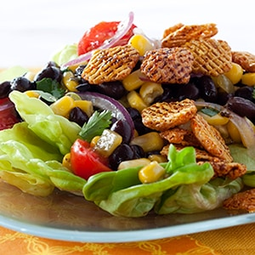
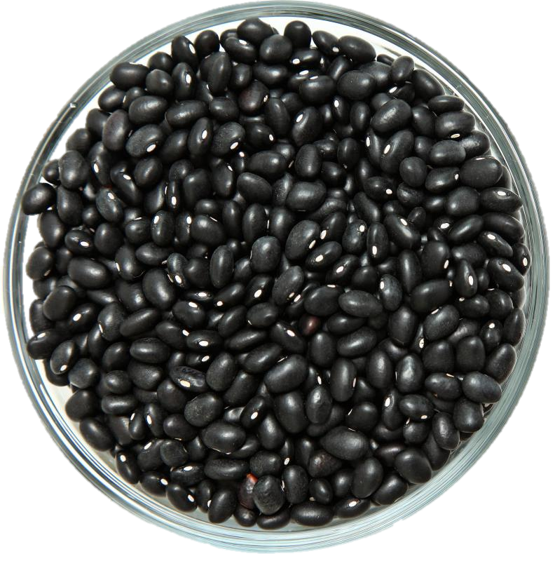
Kitchen Confidence
Recipe videos can help you feel more comfortable with new recipes
It’s okay to “Make” something if you aren’t comfortable “cooking”
Learn how to make a few important basics like beans or roasted vegetables.
Notes:
Script:
You don’t have to be a celebrity chef to enjoy more family meals, but if you want to sharpen your skills in the kitchen,
Set yourself up for success when trying new recipes, focus on one at a time. Don’t try to tackle a meal with several new dishes that you’re not familiar with.
Try recipe videos so that you can understand all the steps before you start
It’s okay to “make” something if you can’t “cook” something. Sandwiches, salads, cereal with plenty of fruit toppings, and other quick fixes are perfectly fine
Master some basic recipes like cooking dried beans or roasting vegetables so that you can easily add more and more healthy low cost dishes to your family’s meal plan

Slide 7



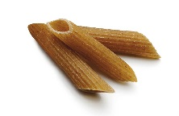





Pleasing Picky Eaters
Notes:
Script:
When you have picky eaters it is tempting to make several different dishes to please everyone. Don’t do that to yourself. Try some of these tips to get your picky eater involved and they will be more likely to try new things:
Involve kids in cooking, find something they can do so that they can get excited about their meal and comfortable with new foods before they sit at the table
Invite kids to choose one component of the meal, having pasta, let them choose a shape, making a salad, let them choose a topping or type of dressing
Have meals that allow for a little customization (tacos, baked potatoes, pasta, etc.)

Slide 8

Budget Friendly Winners: Produce
Get the most out of every season
Enjoy canned and frozen produce too!
Notes:
Script:
Be flexible with seasonal produce and remember all forms of fruits and vegetables count towards better health. Canned, frozen, and dried are healthy too. Go for what is most affordable and least likely to go to waste.

Slide 9

Budget Friendly Cooking Hacks: Beans
Bean Burgers
Sandwich spread
Salads
Notes:
Script:
Get the most out of your WIC foods by thinking of different ways to enjoy them.
Make Bean Burgers
Mash beans to make a savory sandwich spread instead of mayonnaise
Top Entrée Salads with Beans

Slide 10

Budget Friendly Cooking Hacks: Cereal
Oven Fry
Croutons
Meatballs and Patties
Notes:
Script:
Use crushed cereal for oven frying chicken, fish, plantains, and vegetables
Season flaked cereal with your choice of seasoning and use as salad croutons
Use crushed cereal instead of breadcrumbs to stretch meat dishes like meatballs, fish patties, or meatloaf.

Slide 11
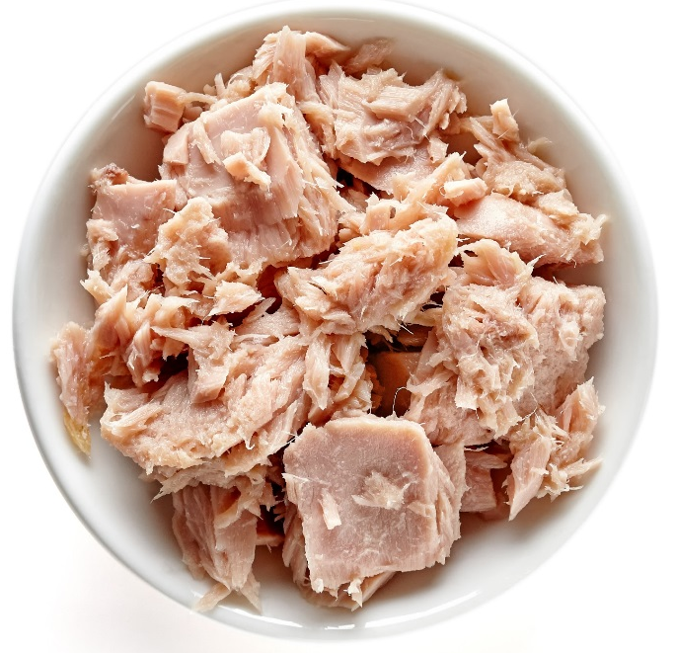
Budget Friendly Cooking Hacks: Canned Fish
Burgers/Patties
Pasta and Green Salads
Rice and Pasta Casseroles
Notes:
Script:
Make tuna or salmon patties or burgers
Add canned tuna or salmon to pasta salads or top off green salads
Make one pot rice or pasta casseroles

Slide 12
Budget Friendly Cooking Hacks: Plain Yogurt
Swap for Sour Cream
Dips/Sauces
Cereal or granola parfaits
Notes:
Script:
Use yogurt instead of mayo or sour cream
Use yogurt make dips or sauces
Flavor plain yogurt with peanut butter, fruit, or spices and enjoy with cereal

Slide 13
ENJOY Mealtime, Connect and Grow Together!
If you could be a superhero who would you be?
What is your favorite kind of weather?
If you could meet anyone, who would it be?
What is the best part of your day?
Notes:
Script:
Now that we have discussed some tips on how to make it easier to get dinner on the table… relax and ENJOY your time together. Remember, most of the social and academic benefits for your children that we discussed are based on having conversations, and checking in with each other.
-Avoid yes or no questions.
-Ask family members about the things they like and the parts of their day they enjoy.
-Need some conversation starters? The dinnerproject.com has pages and pages of fun conversations starters for children of every age on a variety of topics

Slide 14

Take the Pledge!
My Family Will Enjoy One More Meal Together at Home Each Week!
Notes:
Script:
Are you ready to take the pledge?
Here’s the thing, the benefits we discussed are associated with at least 3 family meals a week, but the more meals you have together, 5, 7, 8 the more benefits your family will enjoy.
So we have a simple challenge for you to try this month, use what you have learned to get your family around the breakfast or dinner table at least one more time each week.

Slide 15
Thank You!

